Slide 1
Preregisteration: Why, when, what and how?
Key practices for the language scientist – 29 Nov 2022
Limor Raviv
massive credit goes to:
Guillermo montero-melis, Melanie S. Schreiner, Frauke Beyer, Mariella Paul, center for open science (cos)

Slide 2
Today’s session
Overview of pre-registrations
Why should I preregister my study?
What should be preregistered?
Where can I preregister?
How does it work?
Examples of pre-registered studies
Potential pitfalls (spoiler alert: they are not real pitfalls)
Homework: Try it out!

Slide 3

Let’s briefly discuss:
In general:
What makes you trust a study?
What makes you distrust a study?

Slide 4
Let’s briefly discuss:
And more personally:
Have you ever played around with your data?
Have you ever changed you hypothsis after seeing the results?
(it’s ok to say yes, we’ve ALL been there)

Slide 5
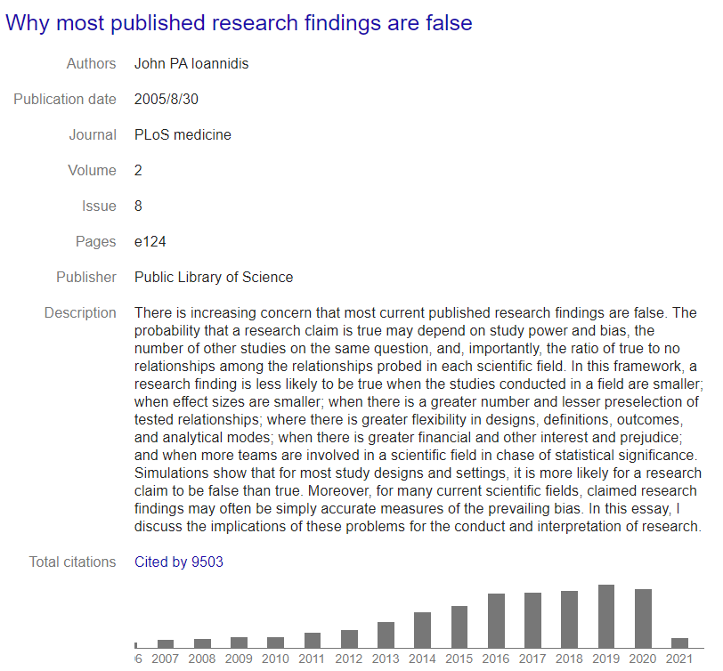
Why Most Published Research Findings Are False
A research finding is less likely to be true when...
Small sample size
Few similar studies
Effect sizes are smaller
There are a lot of tested relationships
There is a lot of flexibility in designs, definitions, and analytical models
There is some financial (or other) interest
Different teams are chasing statistical significance (i.e., in “hot” fields)
Ioannidis, PLoS Medicine, 2005

Slide 6
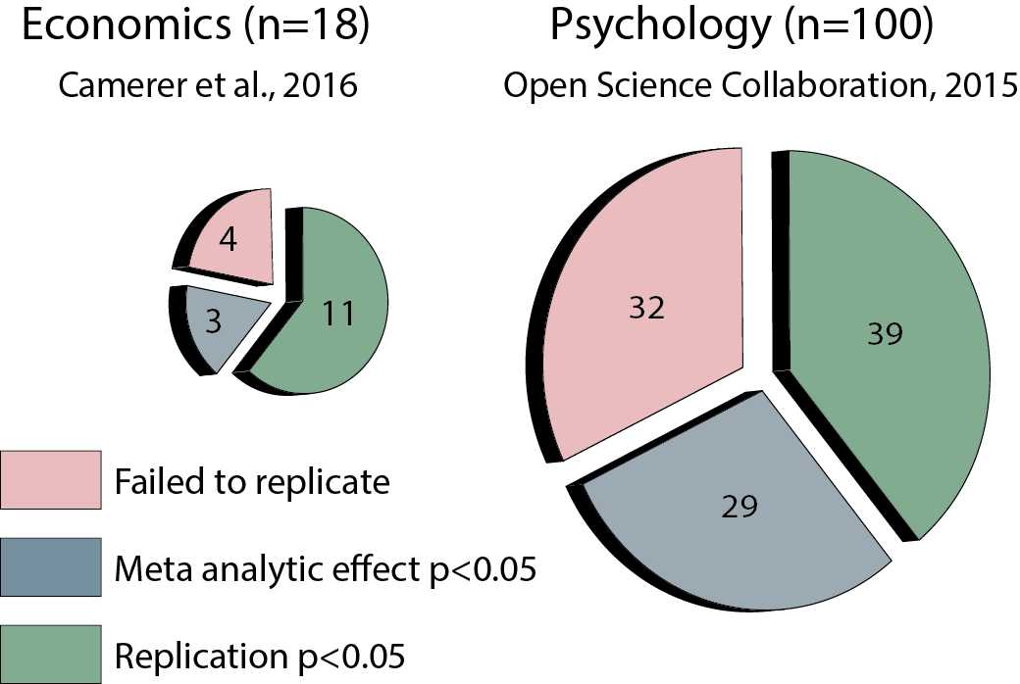
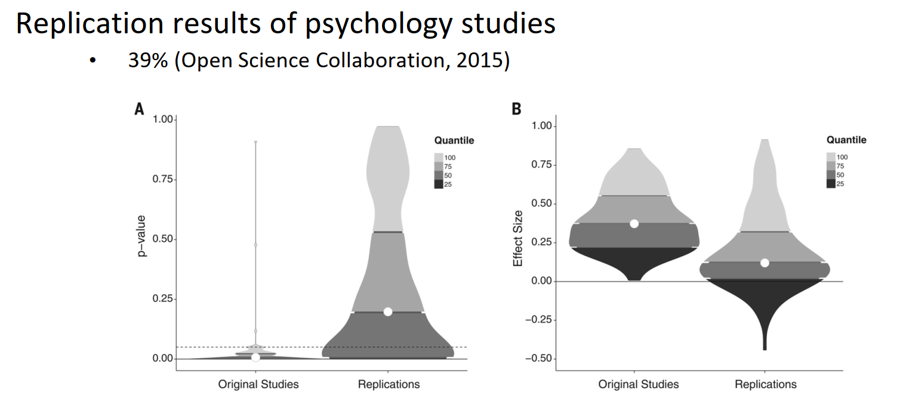
Reproducibility Crisis
Why? Some potential reasons for the replication crisis could be:
• High rate of false positive findings in original studies?
• Low power in replication studies?

Slide 7
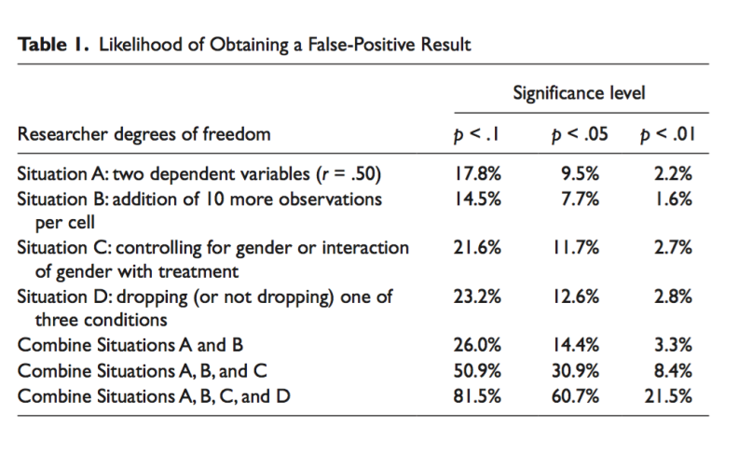
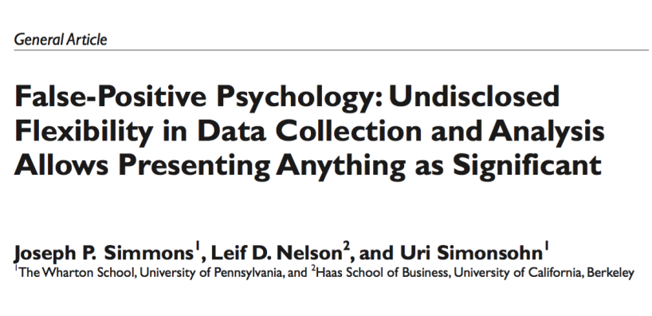
False-positives are VERY easy to get
see also Schönbrodt‘s p-hacking shiny app on http://shinyapps.org/apps/p-hacker/

Slide 8
How we fool ourselves
“All too often, we find ourselves unable to predict what will happen.
Yet after the fact, we explain what did happen with a great deal of confidence. This ‘ability’ to explain that which we cannot predict, even in the absence of any additional information, represents an important, though subtle, flaw in our reasoning. It leads us to believe that there is a less uncertain world than there actually is.”
(Tversky, cited in Nosek et al., 2018)
"The first principle [of science] is that you must not fool yourself - and you are the easiest person to fool." (Richard Feynman)

Slide 9
Anything can become significant with a creative approach....
(Researchers’ degrees of freedome)
Optional stopping (ending data collection when p<0.05)
Selective reporting of variables and conditions
Exclusion of participants („Outliers“)
Conducting tons of analyses but only reporting the one that best fits the hypothesis (“Garden of forking paths”)
Adding covariates to the analysis
Transforming the data
Forming hypotheses post-hoc (HARKing)

Slide 10
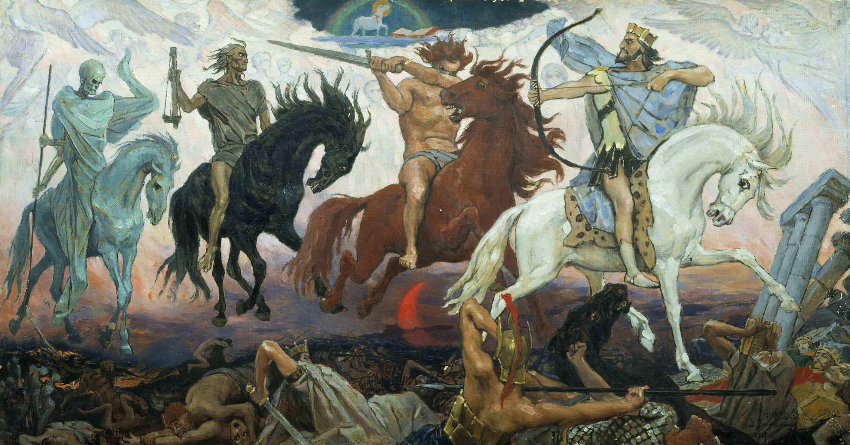
The Four Horsemen of the Reproducibility Apocalypse
HARKing (hypothesizing after results are known): Reverse-engineering a hypothesis from the data and then present it as a priori
Low statistical power: increases the chances of missing true discoveries and reduces the likelihood that obtained positive effects are real
P-hacking (exploiting researcher degrees of freedom): 1) collecting data until analyses return statistically significant effects; and 2) selectively reporting analyses that reveal desirable outcomes. [and trying out different models until we find the “best” one]
Publication bias: journals tend to reject manuscripts if they report null results or undesirable findings
https://en.wikipedia.org/wiki/Four_Horsemen_of_the_Apocalypse#/media/File:Apocalypse_vasnetsov.jpg
Bishop, Nature, 2019; Langer’s (2019) presentation

Slide 11
Possible solutions
Use Open Science practices in your own study
Preregistration
Open materials + open data
Collaborate with other researchers using standardized and transparent study protocols

Slide 12
What is a pregistration?
“When you preregister your research, you're simply specifying your research plan in advance of your study and submitting it to a registry.”
(COS)
“The specification of a research design, hypotheses, and analysis plan
prior to observing the outcomes of a study“
Nosek & Lindsay (2018)

Slide 13
Why preregister?
Makes the research process more transparent
Makes you thoroughly think through your data collection and analysis BEFORE starting
Allows to clearly distinguish between a priori and post-hoc decisions (confirmatory and exploratory analyses)
Strict documentation of studies
Allows others to reproduce your results (with code and data sharing)
Makes it harder to fool yourself and others

Slide 14
Why preregister?
It improves (trust in) research:
“Preregistration separates hypothesis-generating (exploratory) from hypothesis-testing (confirmatory) research.
Both are important. But the same data cannot be used to generate and test a hypothesis, which can happen unintentionally and reduce the credibility of your results. Addressing this problem through planning improves the quality and transparency of your research. This helps you clearly report your study and helps others who may wish to build on it.”
(COS)

Slide 15
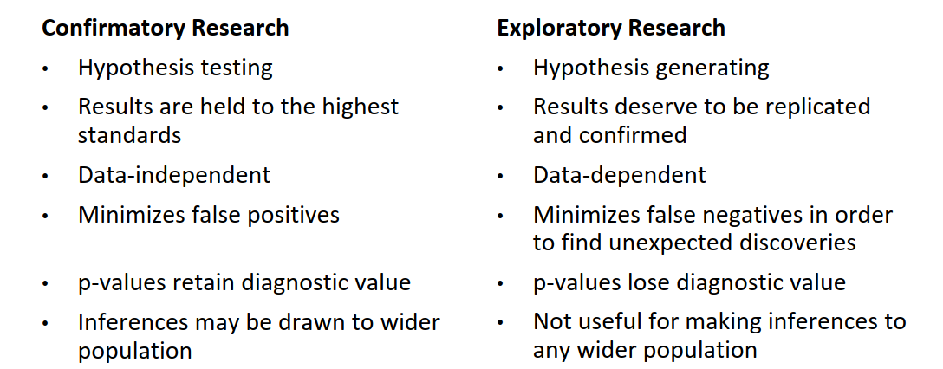
Two types of research:

Slide 16
Preregistration can help because...
Distinction between testing and generating hypothesis is clear in theory but not in practice
Ordinary human biases blur the line between the two
Preregistration distinguishes prediction from postdiction
Widespread adoption will improve credibility of research findings
Nosek et al., PNAS, 2018

Slide 17
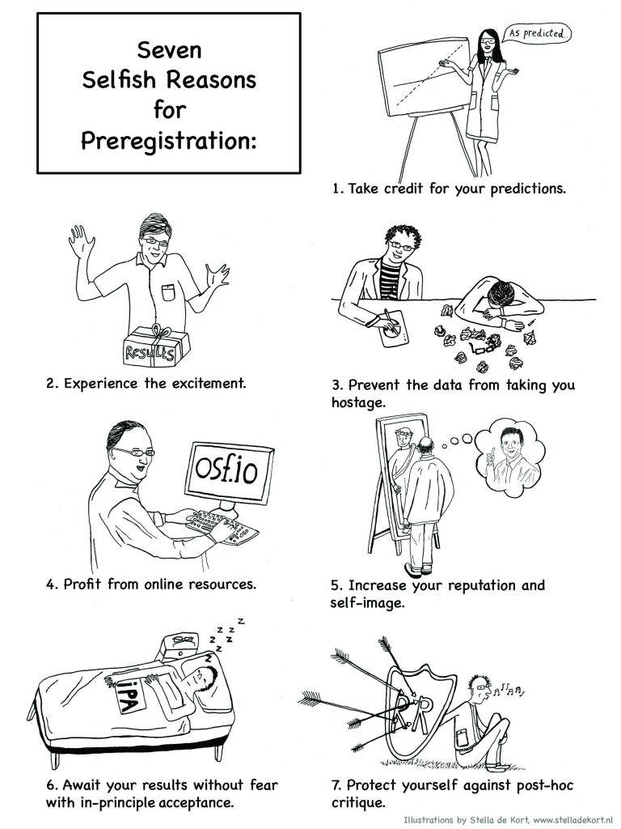
Wagenmakers & Dutilh, APS Observer, 2016

Slide 18
What to preregister?
Hypotheses
What are your predictions? (significant effects, figure of expected results, what does it mean)
2. Method
Study design (materials, procedures), DVs, data collection info (when, where, how many)
3. Analysis plan (confirmatory)
Contrasts, exclusions, data transformations, type of stats, model specification
Basically, everything you can specify beforehand...

Slide 19
What to preregister?
Fixed decisions (e.g., your measures)
“Participants will rate their quality of sleep on 7-points scales (1 = terrible; 7 = fantastic)”
Decision rules for data collection, outlier removal etc.
“If we cannot collect 100 participants until June 5, 2023, we will stop the data collection that very day”
“If a participants doesn’t complete 25% of trails, we will exclude them”
“If RTs are longer than 3s, we will remove the trial from the analysis”
....
Statistical models (ideally analysis scripts / R model syntax, including data-dependent decision rules)
“We will include all random intercepts and slopes. If this full model doesn’t converge, we will first remove the by-participant slope for the effect of X / we will first remove the random effect with the lowest variance...”
Hypotheses and rules for interpretation
“We will interpret a positive significant effect of X as support for our hypothesis that…”
“We do not have specific a-priory hypoythesis for the effect of Y...” (exploratory analysis)

Slide 20
What to preregister?
Some additional things you can add:
1. Do you already know what exploratory analyses you want to do?
“We want to explore the effect of gender...”
2. Data transparency statement: When, where, and what data will be shared?
“All data + code will be shared on OSF six months after data collection”
“The stimuli and the experiment code can be found on this GitHub repository...”

Slide 21
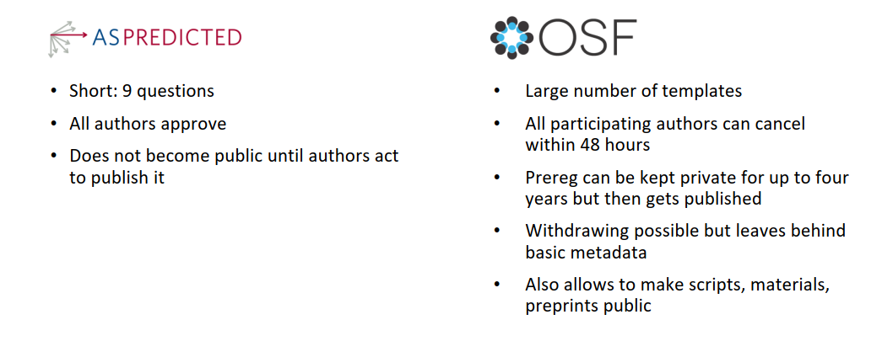
When and where to preregister?
Basically, you may preregister anywhere where you can timestamp documents.
The most important thing is to do this BEFORE data collection (or at least before you’ve looked at / analyzed the data...)
Registered Reports
Peer-reviewed
If carried correctly, in principle acceptance regardless of the results!
Over 300 journals already have this format
Following established templates makes sure you don’t miss anything!

Slide 22
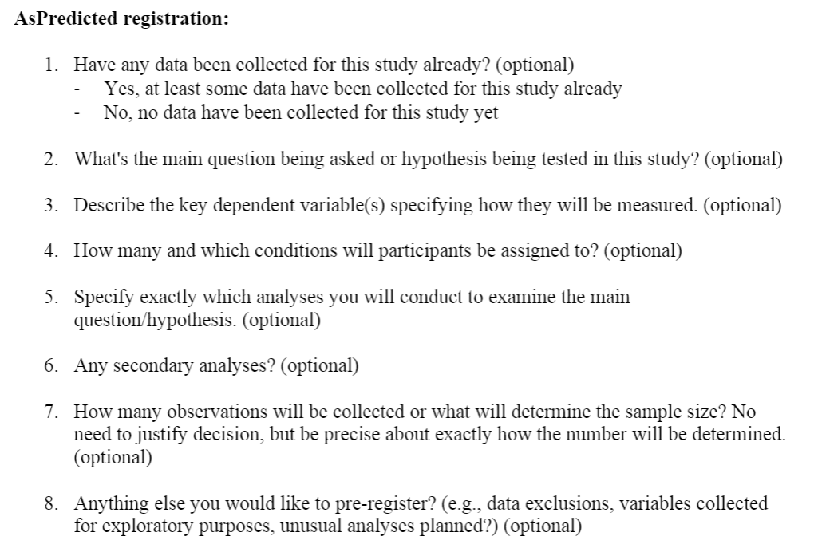
AsPredicted
https://aspredicted.org/

Slide 23

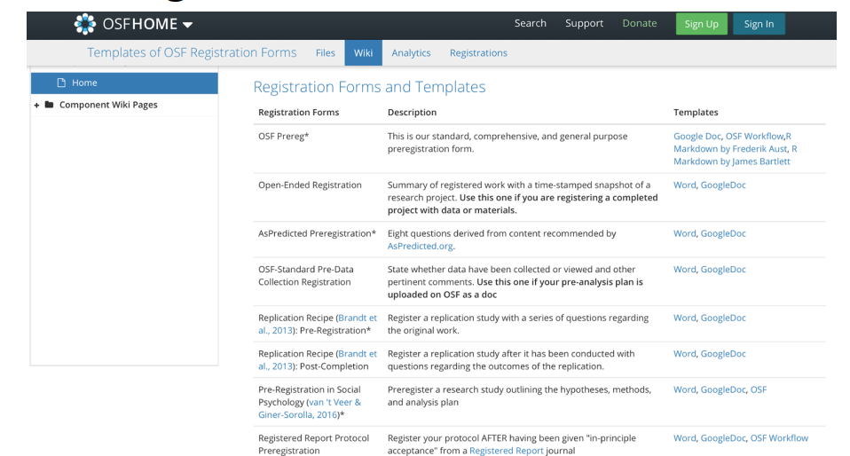
OSF: Registration forms and templates
https://osf.io/zab38/wiki/home/

Slide 24
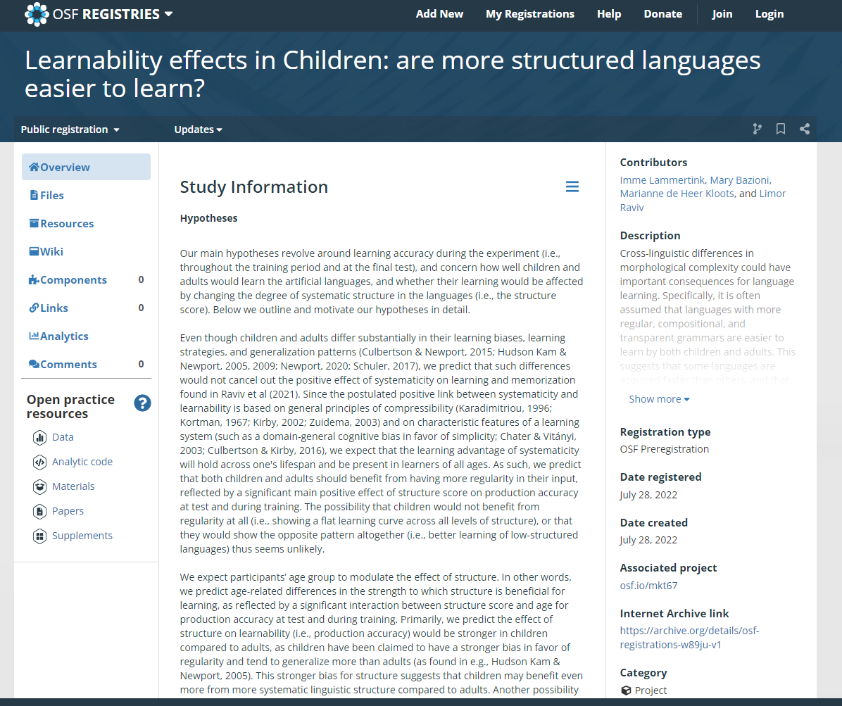
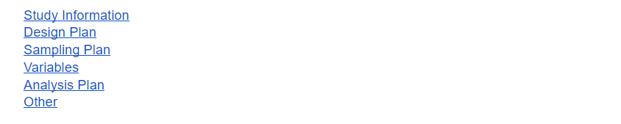
Full preregistration on OSF
25 questions
Example of my own preregistration:
Learnability effects in Children: are more structured languages easier to learn?
(https://osf.io/w89ju)

Slide 25
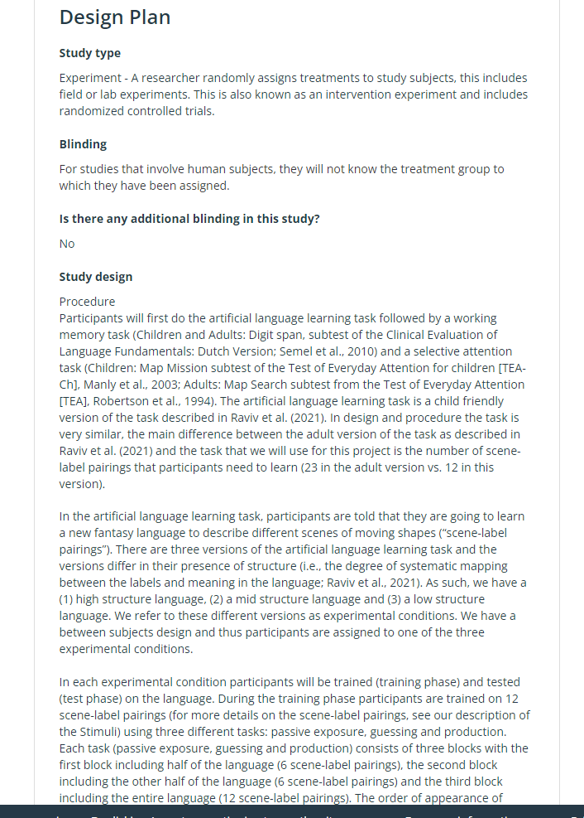
(https://osf.io/w89ju)

Slide 26
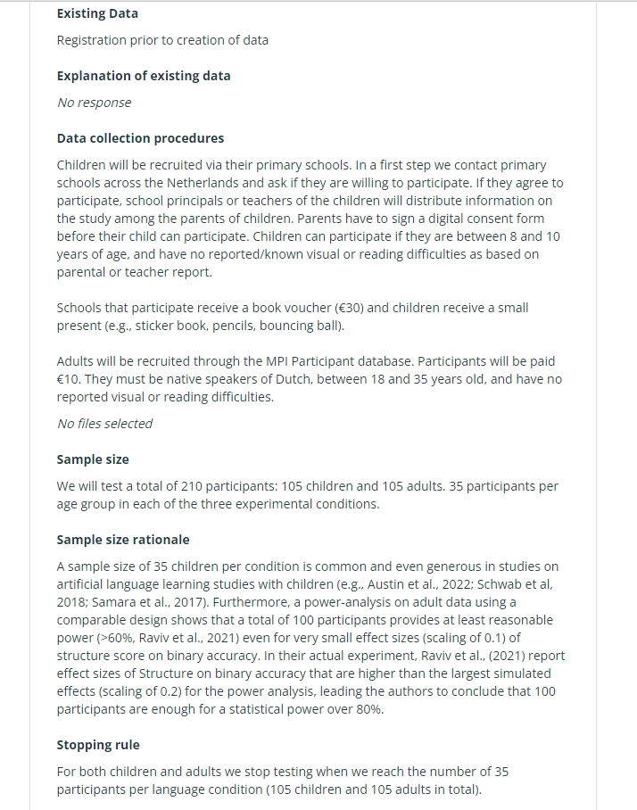
(https://osf.io/w89ju)

Slide 27
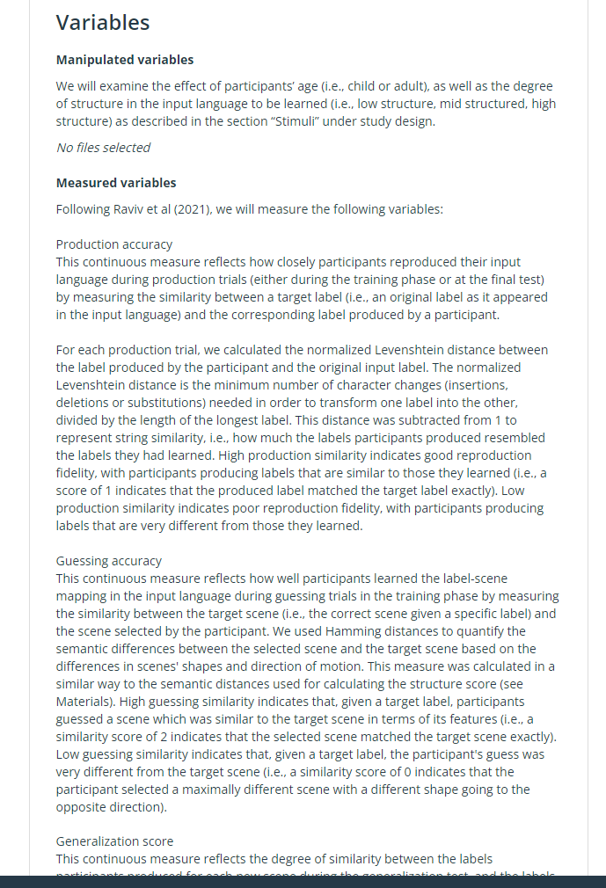
(https://osf.io/w89ju)

Slide 28
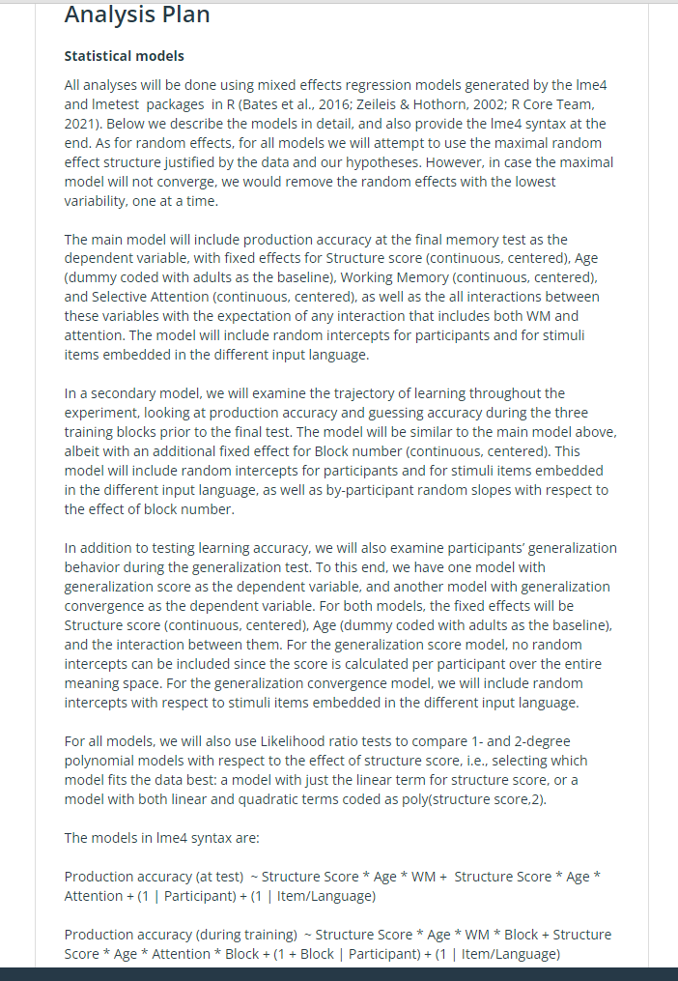
(https://osf.io/w89ju)

Slide 29
Commonly raised concerns
It’s too time-consuming
Mistakes within the pregistration can‘t be fixed later on /
changes after dara collections are not possible
(deviations are not allowed)
Researchers are not as flexible anymore
(exploratory research is devalued)

Slide 30
Commonly raised concerns
It’s too time-consuming
WELL, NOT REALLY, IF YOU THINK ABOUT IT...
It documents decisions you have to make (and often justify) anyway
Thinking carefully about your study before collecting data is probably worth the time you spent on it, especially since critical mistakes in study design cannot be compensated for by fancy analysis techniques later.
When it’s time to write up the full paper, you actually save time because your intro and method section are already written!
Different preregistrations can have different levels of detail (you don’t have to do the full thing..)

Slide 31
Commonly raised concerns
Mistakes within the pregistration can‘t be fixed later on /
changes after dara collections are not possible
(deviations are not allowed)
SIMPLY NOT TRUE!
Deviations from preregistration are very common and absolutely fine as long as you are transparent about it!
You can even update your prerigstration on OSF (time stamped)

Slide 32
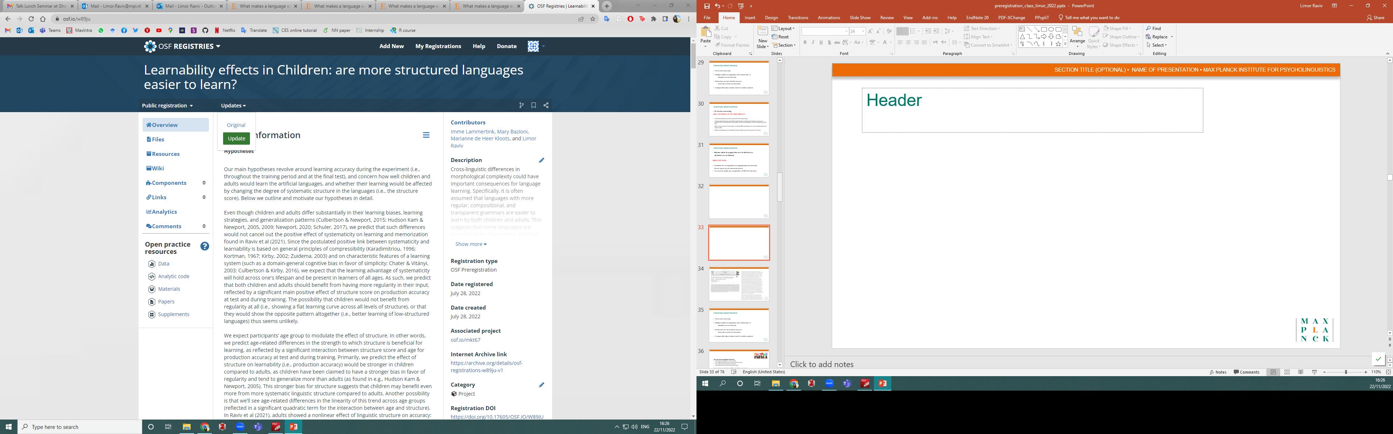
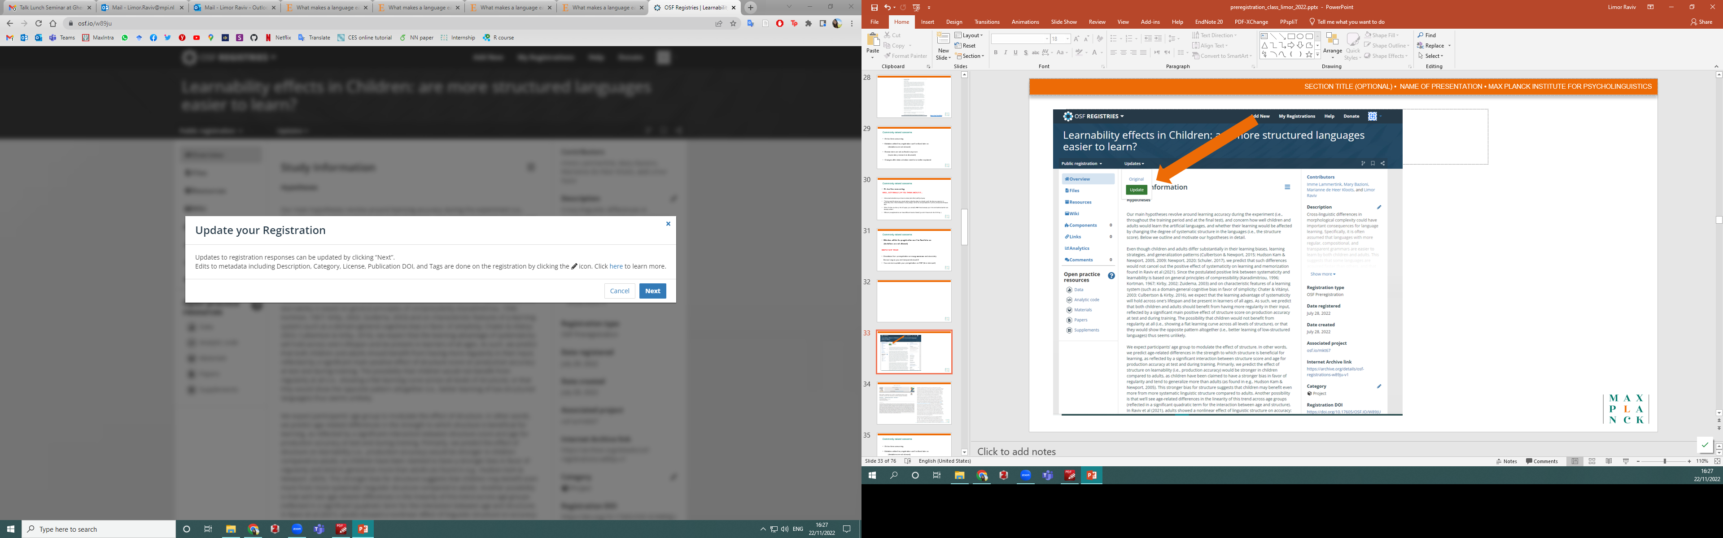

Slide 33
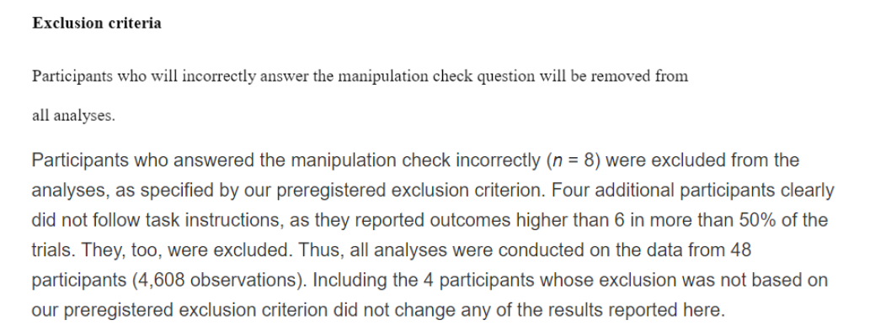
https://osf.io/bh5k4/
https://journals.sagepub.com/doi/full/10.1177/0956797615571018 (Exp. 2)

Slide 34
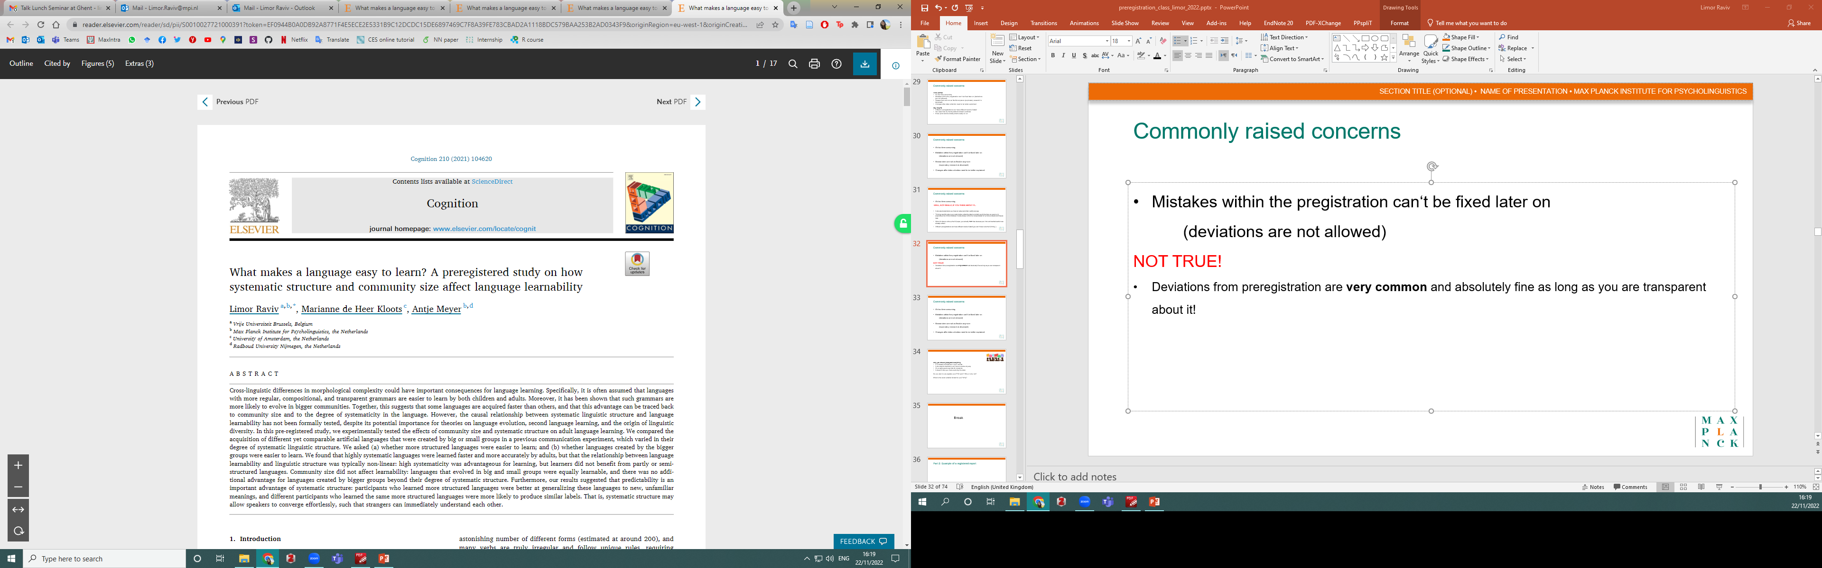
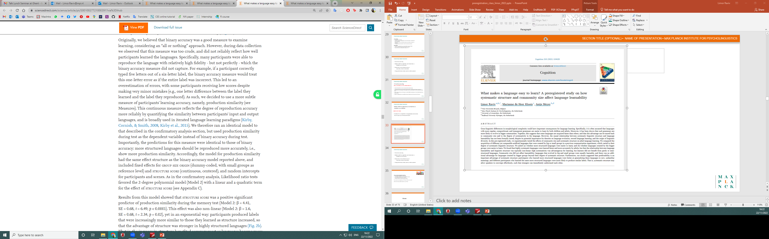

Slide 35
Commonly raised concerns
Researchers are not as flexible anymore
(exploratory research is devalued)
THIS IS A FEATURE, NOT A BUG!
Limiting the flexibility of the researcher is exactly the point of pre-registration...
Exploratory analyses are still possible, but they just cannot be disguised as confirmatory analyses anymore.

Slide 36
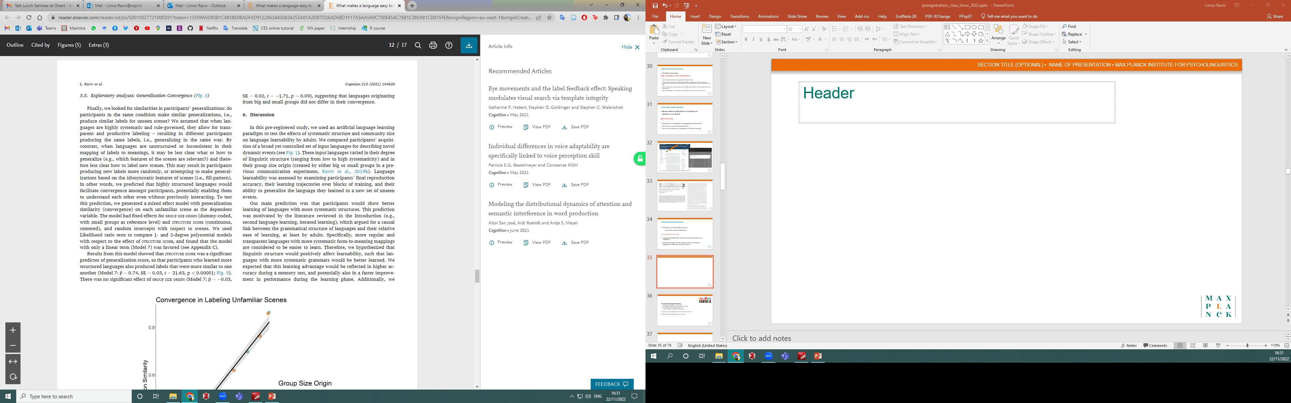
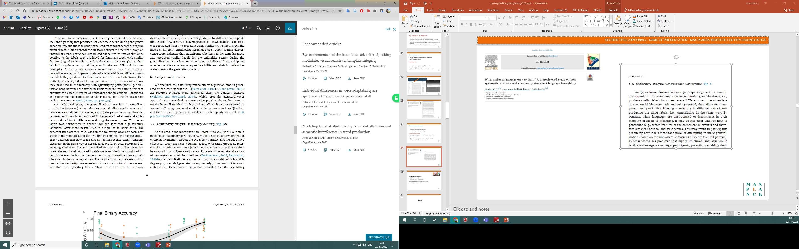

Slide 37
More examples
Example 1: Imaging study (AsPredicted)
Example 2: MRI study (OSF)
Example 3: ERP study using Bayes Factor (OSF)
Example 4: fMRI study preprocessing steps (OSF)

Slide 38
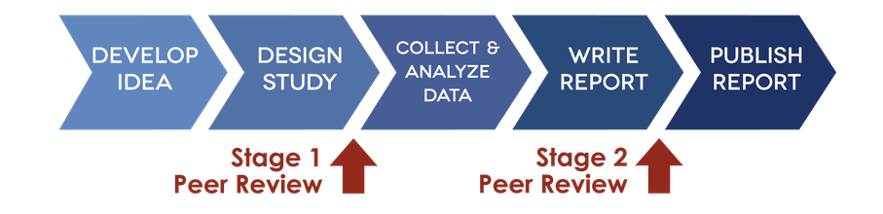
https://www.cos.io/initiatives/registered-reports
Registered Reports
Peer-reviewed pregistration: submission and peer-review prior to data collection
Publication is guaranteed independent of results (assuming you follow the protocol)
Safeguard against reviewer HARKing
"Because the study is accepted in advance, the incentives for authors change from producing
the most beautiful story to the most accurate one.“ (Chris Chambers)
In Principle Accepted (IPA)

Slide 39
Participating journals
List of journals: https://cos.io/rr/
Currently over 300 journals (according to OSF):
Animal Behavior and Cognition
Bilingualism: Language and Cognition
Brain and Cognition
Cognitive Linguistics
Cortex
Developmental Cognitive Neuroscience
Developmental Science
Language and Speech
Language Learning
Linguistics
Nature Communications
Nature Human Behaviour
Psychological Science
Quarterly Journal of Experimental Psychology
.....

Slide 40
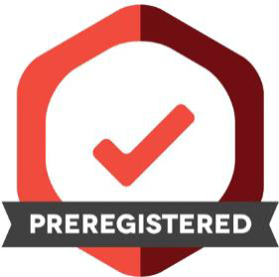
Take-home message
Whenever possible, pre-register by default
It increases confidence in your results
It’s transparent (document decisions you have to make anyway)
It's a really good exercise: you need to think about your study before collecting data!
It doesn't stop you from exploring the data
Remember: We are building a new academic norm. It’s okay to start small, learn from others, and remain critical ☺
Good luck!

